Slide 1

Title: Web Scraping Quotes with Python
Using Requests, Beautiful Soup, and Pandas
Name: Sajina Shrestha (st20307767)

Slide 2
Introduction
Scraping Quotes:
Extract textual data, such as quotes, authors, and tags, from a target website.
Ensure the script is adaptable to handle websites with pagination or dynamic content.
Data Processing:
Clean and structure the scraped data for easy analysis and reuse.
Store the data in a CSV file with appropriate headers.
Error Handling:
Account for issues like network errors, timeouts, or invalid HTTP responses.
Implement mechanisms to retry failed requests and log errors.

Slide 3
Technologies and Libraries
Script Workflow
Title: "Tools Used"
Content:
Python Libraries:
Requests: Fetches web pages.
Beautiful Soup: Parses and extracts HTML content.
Pandas: Stores and manipulates data in a tabular format.
Web Concepts:
HTTP status codes.
HTML structure parsing.
“Overview of Workflow”
Content:
Define a function to handle HTTP status codes.
Create a function to scrape quotes from a single page.
Use a loop to scrape multiple pages until no more quotes are available.
Store the scraped data into a Data Frame and export to CSV.

Slide 4
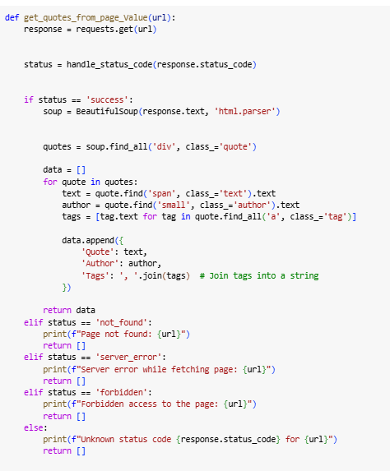
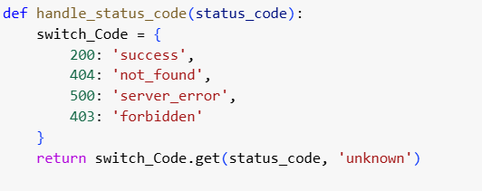
Handling HTTP Status Codes
Scraping a Single Page
Scraping a Single Page
Expiation
Fetches Html content using request
Extracts relevant element like quotes, authors and tags using Beautiful Soup
Title: "HTTP Status Code Handling“
Code Snippet:
Expiation
Maps status codes to descriptive messages.
Helps manage error like 404 not found or 500 server Error

Slide 5
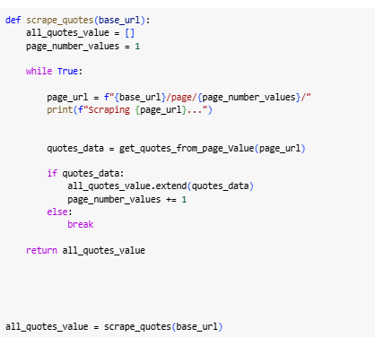

Scraping Multiple Pages
Saving Data to CSV

Slide 6
Conclusion
Automating data collection with Python is both efficient and flexible. It handles tasks like web scraping smoothly, saving time and effort.
With built-in error handling, the process becomes reliable, even if something goes wrong.
You can easily export the collected data for further analysis, reporting, or creating visualizations.

